Slide 1

Hotel chain C
Booking cancelations prediction
Francisco Hermenegildo, 20200737
Gil Gonçalves, 20201066
Ikram Bouziri, 20200753
Unrestricted

Slide 2

Plan
Dataset overview
1
Current Situation
2
Net Demand
3
Potential Situation
4
General Insights
5

Slide 3






Dataset overview
≈2
105€
79.330
Average nº adults per booking
ADR
Bookings
≈3 days
31
Average Length of Stay
Features
2015-2017
Bookings from

Slide 4


Current Situation
42%
10.9 M€
97%
5%
15
of total reservations end up canceled
in lost revenue
of the bookings come from new customers
of national clients repeat the stay
out of 115 weeks have more cancelations than checkouts (13%)
€
cancelations
check-out

Slide 5
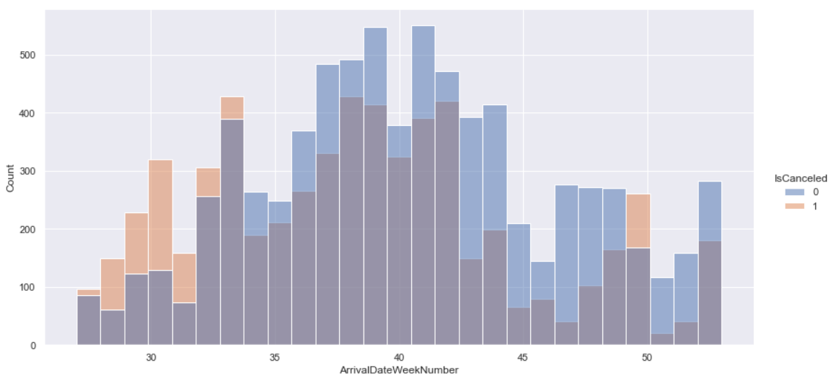
Net Demand
2015
Insights
Existence of more cancellations than successful bookings on weeks 27 – 33 and 49
Avg of 222 cancelations per week
284 checkouts
56% of total bookings result in a checkout

Slide 6
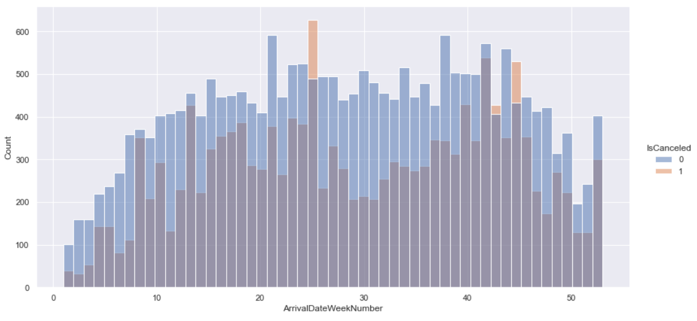
Net Demand
2016
Insights
More cancelations than successful bookings on weeks 25, 42 and 44
Avg of 291 cancelations per week
Avg of 430 checkouts
60% of total bookings result in a checkout

Slide 7
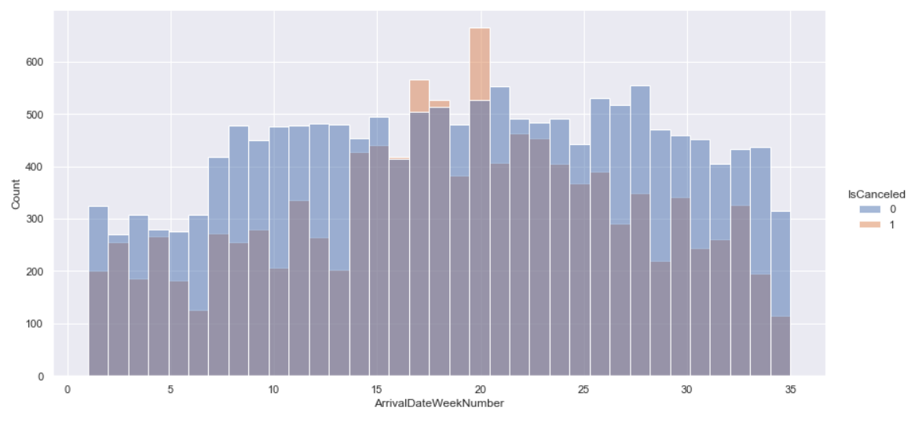
Net Demand
2017
Insights
More cancelations than successful bookings on weeks 16 - 18 and 20
Better performance compared to 2016 (same time period)
Avg of 334 cancelations per week
Avg of 452 checkouts
58% of total bookings result in a checkout

Slide 8
Net Demand/week Yearly Comparison
2015
2016
2017

Slide 9
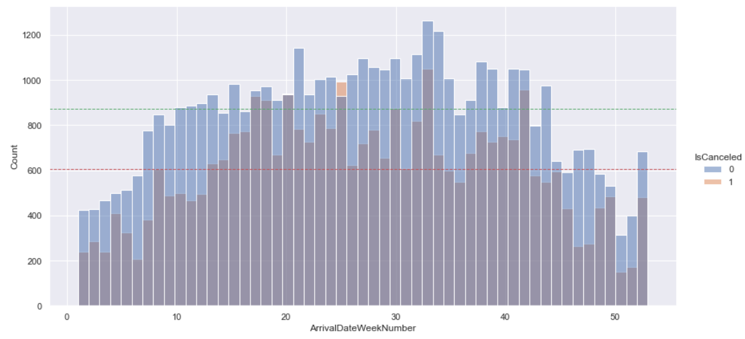
Jul 2015 – Aug 2017

Slide 10

Potential Situation
85%
Accuracy of the model to predict the outcome of a booking
If used to support the decision-making process in a real-time basis:
The target of reducing cancelations to a rate of 20% can be achieved;
Overbooking policies will be adapted to the forecasted net demand;
Adjusting the pricing and restrictive cancelling policies to prevent expected booking cancelations.

Slide 11
Key Suggestions
1
2
3
Reinforce the overbooking policy on weeks with high cancelation ratio.
Implement policies that discourages customers from cancelling on the day of arrival (savings around 400k €).
Take a closer look to the customers that cancel less than 5 days before the arrival date since they represent 10% of total reservations and lost revenue.

